Slide 1
GPAS & Billing
In Sprint testing deep dive

Slide 2
Topics
1. Assurance comments – Update
2. Testing Deep dive
  Thorough In sprint testing
  Robust US sign off proc
  In sprint test automation
  API / Integration testing
  Collaboration
  Gen AI Opportunities

Slide 3
Assurance comments and update
Sr . No | Title | Update
1 | Availability of Stubs | Stubs are combination of a Playwright script which is already available in central repository, Submission payload template is available, test data will be user defined. For EBT we have established a process and supporting test data creation: Close to 20 data sets requested by Manuel are already setup in the test environment Any further Business to provide test data requests and test team can generate the records
2 | User Story Demos Need a day’s notice | Demo invites are sent weeks in advance We communicate as early as practically possible taking into account internal reviews We will send out a view of our plan for demos but this may be subject to change in order to hold the sprint completion date and / or maximise velocity. Mitigation – POs and test assurance team have visibility of all US that are in “Ready for showcase” and this can serve as a refresher to their involvement in Elaboration.
3 | Criteria in DOD | We implemented a process improvement back in Sprint 3 – there are now 12 items on a checklist which we walk through as part of the demo and ensure all are closed prior to requesting sign off.
4 | Negative scenario and boundary value cases are not covered in Sprint testing | Negative and Boundary value test cases are covered and these tests are also run during the US demo. Test Assurance (TA) comments are reviewed and addressed. Response to the current list of comments are provided to the TA team. Current status: Total count : 57 | No action required: 47 | Correction required: 3 | Clarification still in progress: 7 As part of the In-Sprint deep dive session “In sprint testing” we will demonstrate examples.
5 | Exception handling | Functional exception (UI based validations related to business rules) Exception handling is done at postman level for Cloud APIs. This is triggered by submitting incorrect payloads. Testing exception scenarios with MDA topics need to be covered e2e with MDA team support LOQATE service not available and daily count limit Message retry for Kafka topics design is being agree with Guidewire
6 | Error logging | Errors encountered at Cloud API and Integration Gateway are logged in the application log. Errors are logged into the Application error log and available in DataDog

Slide 4
Testing Deep Dive Session Summary
Need for testing
What are we doing?
Shift left, Automation first
API testing (Integration limitation)
Traceability
Testing standards and KPI
Governance
Engineering capability
Setting the foundation for E2E, UAT
Thorough In sprint testing
Robust US sign off proc
Negative and Boundary testing
100% AC coverage, OOTB testing
BCM, Rules, FLS & User role testing
Full traceability in Jira
Workflow to indicate demo candidates early
Meetings are pre-booked
Observations noted and actioned
In sprint test automation
API / Integration testing
Overall functional coverage >90%
Progressive automation (n-1)
TA approved code check in
Execution records in Jira
API testing for unavailable integrations
API test experts to design payloads to run tests
Collaboration
Gen AI Opportunities
Coordination with integration system contacts
Support to E2E
Test data for EBT
Working with Dev
Capgemini’s GW cloud instance running CI LOBs
Use cases tested with CoEs
Other potential utilities for GPAS: Smart form and Rating testing

Slide 5
In sprint test process
User Story Refinement
and Dev process
Test Prep in parallel
  Test design coverage: All AC’s, BCMs, FLS document, Confluence page for any additional information
  Test cases naming: Mention AC#, BCM#.
  Test cases review: Peer review, Review by BAs. BA reviews are formal and can be evidenced in Teams meetings
  Traceability: Link Test cases to user stories in Jira.
  Headstart test automation: by developing test cases in BDD.
Examples for walkthrough
BZPC-232
BZPC-356
BZPC-367
BZPC-365
BZPC-381
BZPC- 827
Ready for test
Unit test review: Dev handover meeting to review the unit test results and check lists (evidence attached in Jira).
Show n Tell: Dev team demonstrated that the US is working by running few tests
In testing
Test execution: 100% planned test cases execution with test evidences.
Leverage Automation: Data setup, high volume validation tests
Defects: Linked to test cases
Ready for Showcase
Internal review: BAs quiz the test team on coverage. US that fail at this stage are held back ‘In testing’
Ready for showcase: User story status changed only after successful review.
In Sprint testing metrics
Test cases | Sprint 1 | Sprint 2 | Sprint 3 | Sprint 4 | Sprint 5 | Sprint 6 | Total
Policy Center | 40 | 59 | 123 | 145 | 226 | 240 | 833
Billing Center | 26 | 32 | 41 | 48 | 75 | 46 | 268
Integration | 27 | 37 | 39 | 13 | 49 | 12 | 177
TOTAL | 93 | 128 | 203 | 206 | 350 | 298 | 1278
Total defects Including S 6 | Reported | Resolved | Outstanding | Deferred
 | 278 | 230 | 18 | 30
* only defect with target resolution S1 – S6
< Back

Slide 6
User story demo and sign off
Meeting invites
Pre-planned meeting invites agreed with PO, BA & Build teams & circulate begninng of sprint
Ensure to share list of "Ready for Demo" user stories
Note: QA team ensures Cloud Assurance standards , GUNIT logs & Test coverage for each user story as per DoD
Demo sessions
Demo covers below key aspects with application walkthrough:
  100% acceptance criteria
  Business rules
  FLS & History events
  Role based
  Negative & Boundary test conditions
  DoD checklist with evidences
Summary of observations
Capture consolidated demo observations
Discuss & agree next steps on observations
Ensure to log demo observation in JIRA for tracking
Story moved to done
Successful demo of a user story will be assigned to designated PO in JIRA
PO approves US
< Back

Slide 7



In sprint test automation
Determine the scope
Sprint 1 - 5
Work streams | Testable user stories | Automatable Candidates for Regression Testing * | % of functional coverage automated for regression testing **
Policy Center | 84 | 64 | 76%
Billing Center | 59 | 52 | 88%
Integration | 26 | 21 | 80%
* Assessment log in share point. 8 in PC are assessment in progress
** Projects tend to include a range of 50-70% of functional coverage in automatable regression
Test cases execution till end of Sprint 5 | BZ Billing Center | BZ Integration | BZ Policy Center | Total (test run in progress, count may vary
 | 112 | 70 | 261 | 443
API test automation (case ingestion)
User selects the record to be ingested
Case ingestion
Int G/W
Cloud API
Framework for ingesting submission. Playwright test automation tool at the core.
Payload
Template
Playwright orchestrates the process to iteratively populate payload template and submit request to GW
Some of the elements of the data highlighting coverage 50+ unique records | Marketable products | Policy lines | Business category | UW Company | Org Type | Ins structure | Others …
 | Advanced Boardroom & Co Protection | ML D&O | Admitted | BICS | Corporate Public | Primary | Coverages Modifiers Insured details Producer and COB codes Trifocus codes
 | Execuguard | ML EPL | Surplus | BESI | Private | Excess
 | Armour boardroom Protection | ML Fiduciary |  | BICI
 | Beazley boardroom protect |  |  | BUSA
< Back

Slide 8
API / Integration testing
Integration | What services tested | What services not tested | Comments | Transaction Covered
UWWB | IG Composite Quote API Cloud Quote API IG Quote Update API Cloud Quote Update API Cloud bind API Quote status update API | IG Bind API IG Renewal API | API’s are tested using agreed schema contract which will be used by UWWB once integration is established. Different payloads are created to test marketable product quotes with different coverages . Different set of test data is created to trigger different business rules as per requirement . | Account creation Submission Full Quote Quote Versions Policy Bind Renewal Quote
PC-BC Integration | BillingAPI – New Bunsiess charges, Policy Change charges , Renewal charges ,Cancellation Payment plan API |  |  | New business Policy change Renewal Cancellation
loqate | Address Verification |  |  | New business Policy change
IDP(Users and team) | Users Create , update |  | Testing is in progress. Testing is carried out by updating data in Central Services domain system to publish message on kafka and will consumed by GPAS | User creation/Update from IDP to Guidewire
Cap IQ (Central Services domain) | Credit score updates |  | This is tested by updating data in (Central Services domain) which triggered event to publish on kafka topic and consumed by GPAS then updated in guidewire | Credit score updates from finance system to Guidewire
LexisNexis – Sanctions(Central Services domain) | Sanctions Updates | UW control - Sanctions | Sanctions Updates is tested by updating data in (Central Services domain) which triggered event to publish on kafka topic and consumed by GPAS then updated in guidewire | Sanctions Updates from finance system to Guidewire
MDM |  | Customer update | This will be tested in coming sprint , once story is ready for testing . | Customer update from MDM to Guidewire
CRM |  | Producer , organization creation/updates | This will be tested in coming sprint , once story is ready for testing . | Producer , organization creation/updates from CRM to Guidewire
Appian | Activity updates | Message consumption by Appian | This story is tested by validating if messages is delivered to Kafka topic or not . | Activity data sent to Appian from Guidewire.
UW Controls |  | LexisNexis – Sanctions Broker Validations | This will be tested in coming sprint , once story is ready for testing .
MDA |  |  | This will be tested in coming sprint , once MDA build is done
Guidewire App Event - MDA | New Business Bind | Renewal – Bind Policy Change | This will be tested in coming sprint , once MDA build is done
Aggreso |  |  | This will be tested in coming sprint , once story is ready for testing .
Document Generation and Management |  |  | This will be tested in coming sprint , once story is ready for testing .
< Back

Slide 9
Collaboration
Coordination with integration system
Objective: prove integration connectivity ahead of stablisation phase where integration system is available
Dependencies: Co-ordinate with Beazley integration manager / point of contact for Touch Point Plan (TPP)
Coordination: Florin: Users and Teams | Stuart: CRM | Margot: MDM | Kinga: Claims | Razvan: Lexis Nexis | Eloy : Kafka Configuration
Artefacts
Dependency log
Build contents
Test data sheet from business
Support early E2E
Sprint complete build: full trail available of build contents on confluence release notes page
Capgemini developed automation scripts: to support with E2E environment validation
Early E2E observations: Process established to review, validate and confirm which observations are defects
Test data for EBT
Test data request for E2E: data requests reviewed, clarifications resolved, and data setup activity completed
Automated test data setup: excel test data sheet provides the required flexibility
Working with Dev
Build & Defect Fix ETAs: team standups, active Teams chat to agree target dates
Capabilities built in testing: Build deployments, ADL, Contact manager, Time travel, Job runs
< Back

Slide 10
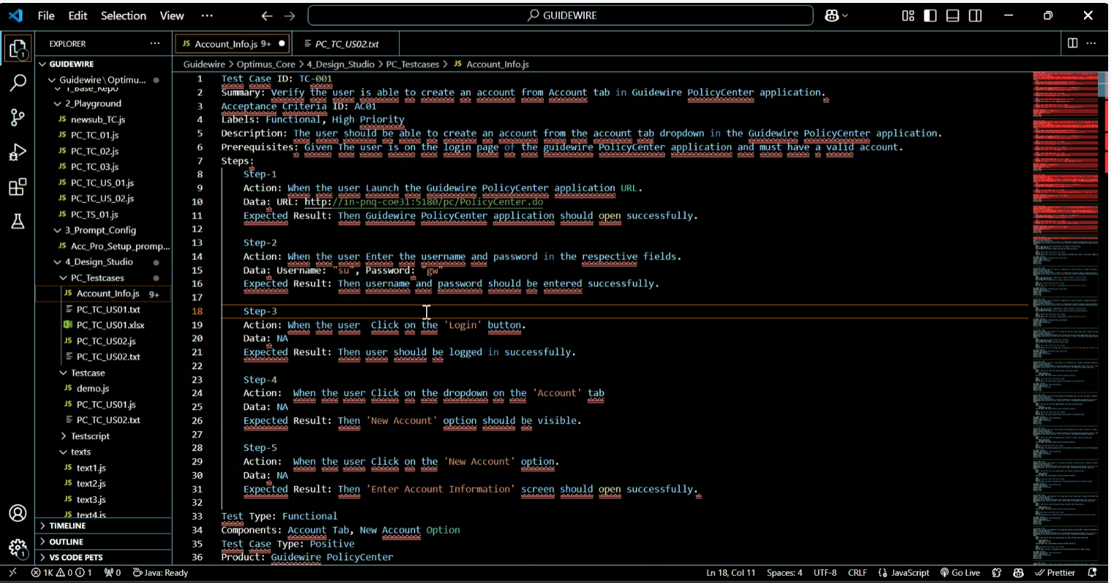
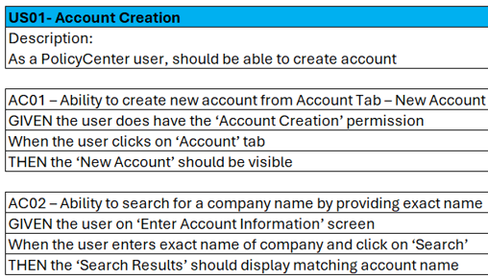
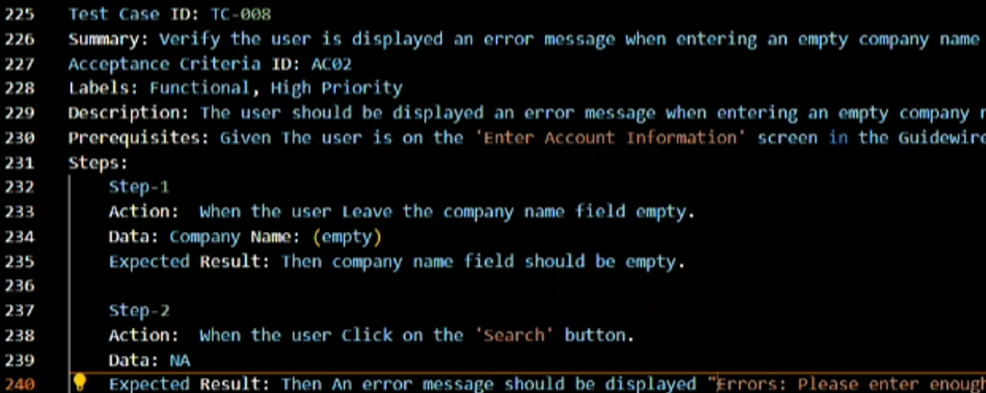
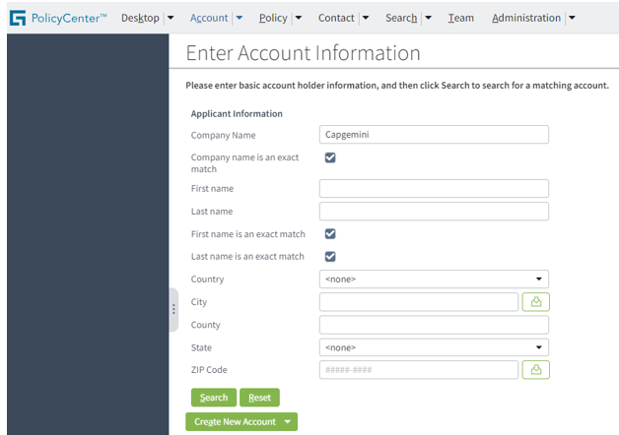
Gen AI Opportunities
Use cases related generation of test cases, automation scripts and test data on GW Cloud instance running CI products
Input
Process and Output
Sample user story
GitHub Copilot enterprise license
Copilot Chat on GitHub
Visual Studio Code
One of the negative test case
Capgemini’s Guidewire test instance
< Back

Slide 11
APPENDIX

Slide 12








GPAS testing champions
Anchal
Ravi
Komala
Sridhar
Abhiram
Sandeep
Vijaya
Pavan
Rahul

Slide 13

Testing Assurance Measures
In Sprint testing measurable KPIs – All info available in Jira
100% planned test execution * | Traceability matrix in Jira | Functional regression coverage Automated | Minimum one full automated regression run each Sprint (n-1) | Defect rejection % | % of ad-hoc defects | DOD Sheet filled for each US
Always met | Always met | 90% + | Always met | < 5% | < 10% | Always met
Sprint exit report provides insights into the Sprint test metrics
* Exception - test cases for deferred User stories
Test coverage with traceability – Jira for test cases and defect management
Test cases | Sprint 1 | Sprint 2 | Sprint 3 | Sprint 4 | Sprint 5 | Coverage highlights
Policy Center | 40 | 59 | 123 | 145 | 226 | All acceptance criteria FLS, BRs, User roles Negative tests Data variations
Billing Center | 26 | 32 | 41 | 48 | 75
Integration | 27 | 37 | 39 | 13 | 49
TOTAL | 93 | 128 | 203 | 206 | 350
Total defects | Reported | Resolved | Deferred *
 | 209 | 202 | 7
* Emerge from requirement update, deferring of story
Test assurance team conduct test case reviews.
Collaboration with POs.
Submission test data – based on integration specifications
Some of the elements of the data highlighting coverage 50+ unique records | Marketable products | Policy lines | Business category | UW Company | Org Type | Ins structure | Others …
 | Advanced Boardroom & Co Protection | ML D&O | Admitted | BICS | Corporate Public | Primary | Coverages Modifiers Insured details Producer and COB codes Trifocus codes
 | Execuguard | ML EPL | Surplus | BESI | Private | Excess
 | Armour boardroom Protection | ML Fiduciary |  | BICI
 | Beazley boardroom protect |  |  | BUSA
Test data setup is 100% automated.
Supported test data setup for EBT.

Slide 14

Testing Assurance Measures
In Sprint automated regression testing
Functional regression testing – Sprint 1-4
Work streams | Testable user stories | Automatable Candidates for Regression Testing * | % of functional coverage automated for regression testing **
Policy Center | 60 | 52 | (47) 90%
Billing Center | 41 | 35 | (35) 100%
Integration | 24 | 21 | (19) 90%
Scalable and Extendable framework with ability to rapidly onboard new LOBs
Test scripts leveraged to validate E2E env
* Assessment log in share point. Projects select a subset of automatable candidates for regression
** Projects tend to include a range of 50-70% of functional coverage in automatable regression
Test cases execution till end of Sprint 5 | BZ Billing Center | BZ Integration | BZ Policy Center | Total
 | 63 | 50 | 171 | 284
API test automation (case ingestion)
User selects the record to be ingested
Case ingestion
Int G/W
Cloud API
Flexibility to update data sheet, payload template.
Extendable to new LOBs.
Framework for ingesting submission. Playwright test automation tool at the core.
Payload
Template
Playwright orchestrates the process to iteratively populate payload template and submit request to GW
User story workflow and sign off
User Story Refinement
Development process and build completion
Ready for test
In testing
Ready for Showcase
Done
Test prerequisites
completed
Tests passes
Defects closed
DOD criteria met
US successfully demonstrated to PO
Only POs move US to DONE.
DOD spread sheet filled
Handover session
Unit test review
Test design runs in parallel

